Slide 1
Logic COMP2620/COMP6262/PHIL2080
Tutorial
Week5

Slide 2
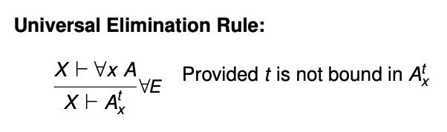
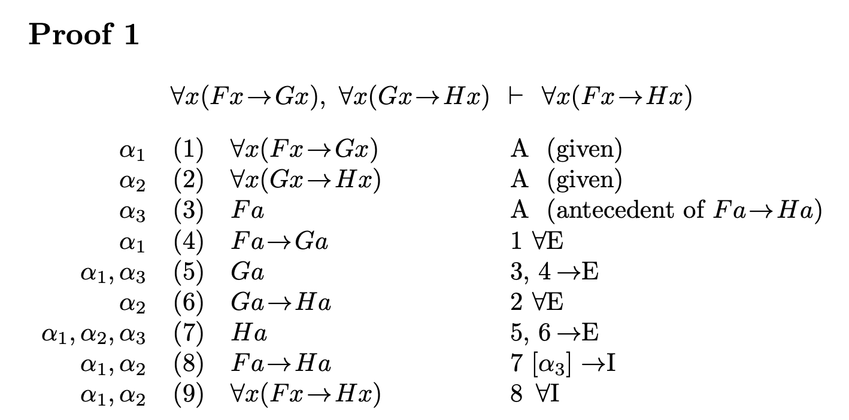
The conclusion ∀x(F x→Hx) is universal in form
we aim to get the conclusion from a typical instance Fa→Ha
→I strategy applies: we assume its antecedent (line 3) and derive its consequent (line 7)

Slide 3
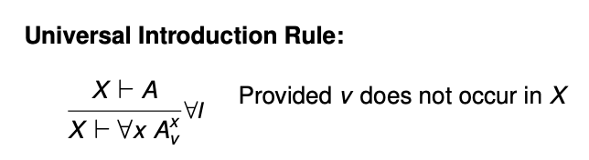
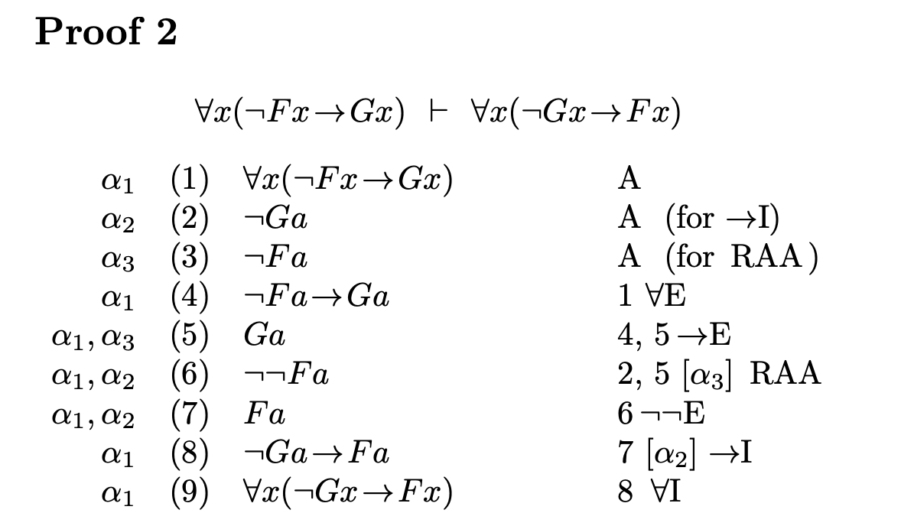

Slide 4
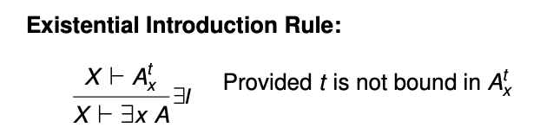
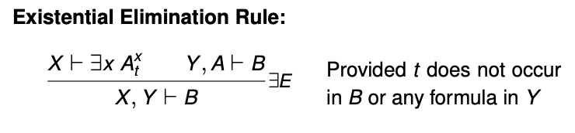
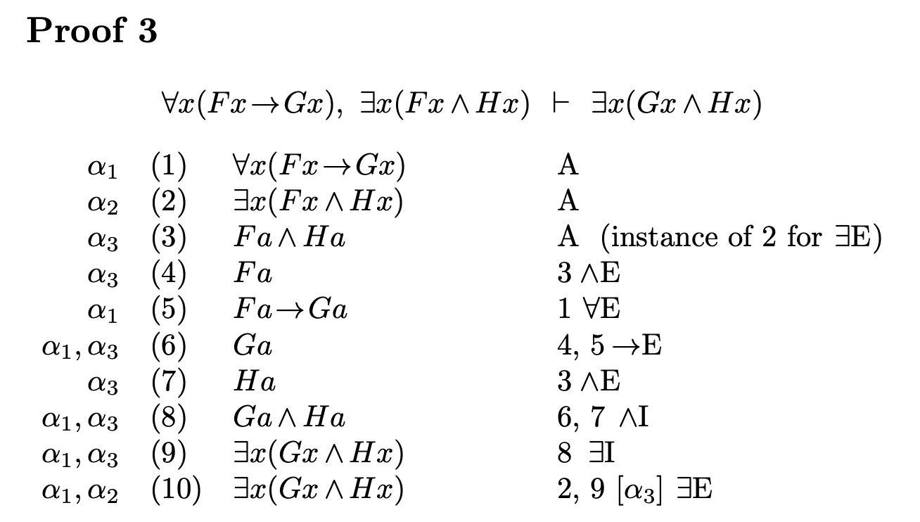
Do not forget to check the side condition
x is substituted by t
t is substituted by x
Free variable
If there is some quantifiers, the sequence is a Bound variable.
If not, it is a free variable.
“Gravity falls”
Existential Elimination Rule
x=x,t=a
A=Fa ∧ Ha, B=Fx ∧ Hx
We have to make it α1, α2 from α1, α3
So, using ∃E try to eliminate α3

Slide 5
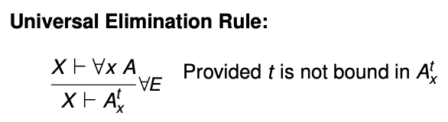
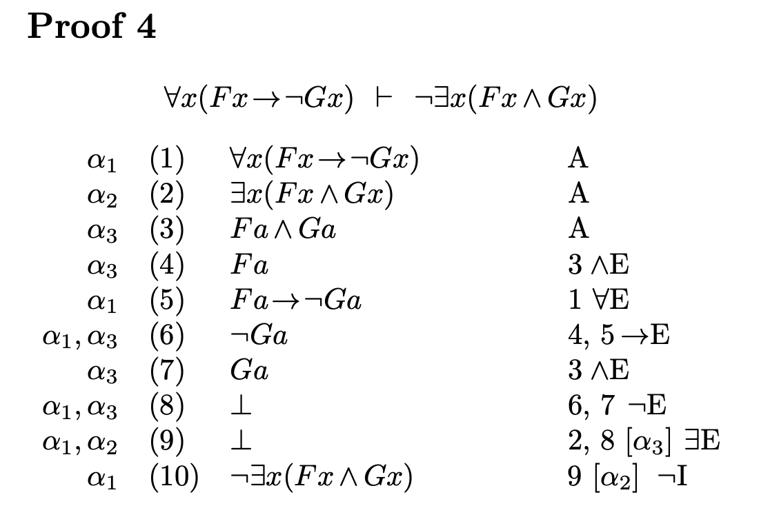
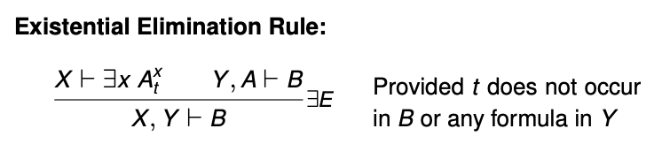
We assume ∃ part
We do not have to assume Fx in this case, we only assume if there is in consequent
Existential Elimination Rule
x=x,t=a
A=Fa ∧ Ga, B=Fa ∧ Ga
Bottom= contradict

Slide 6
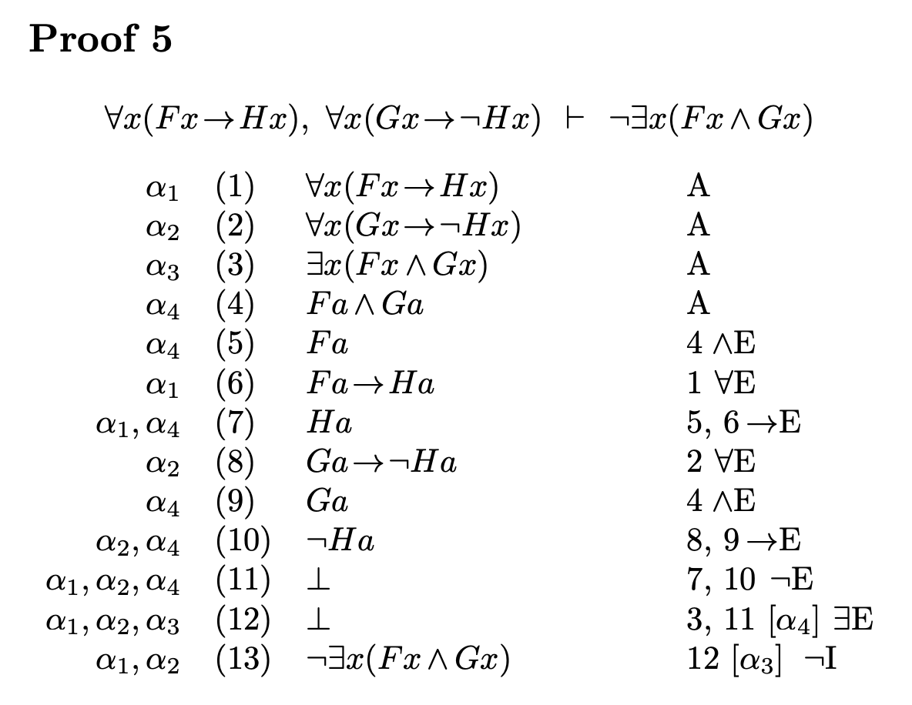
Existential Elimination Rule
x=x,t=a
A=Fa ∧ Ga, B=Fa ∧ Ga

Slide 7
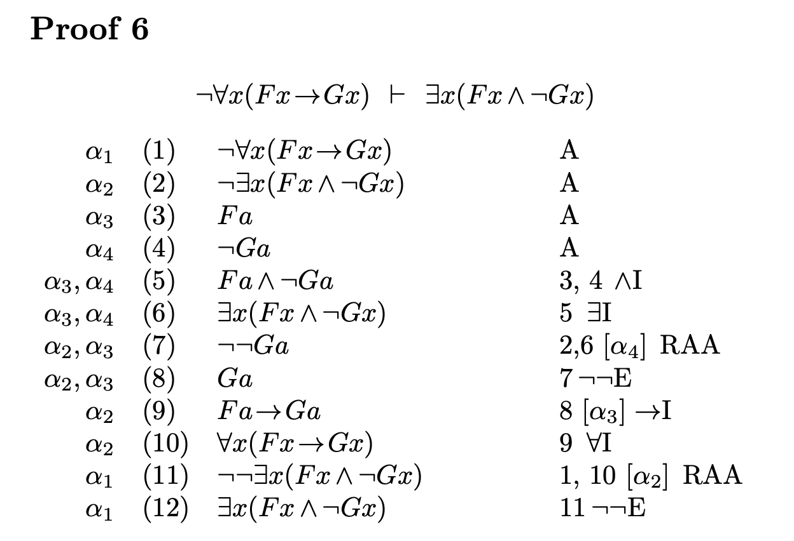
Proof 6. ¬∀x(F x→Gx) ⊨ ∃x(F x ∧ ¬Gx
Let’s see De Morgan's Laws
We cannot prove it in intuitionistic logic; we can only prove it in classical logic, and we must do so indirectly

Slide 8
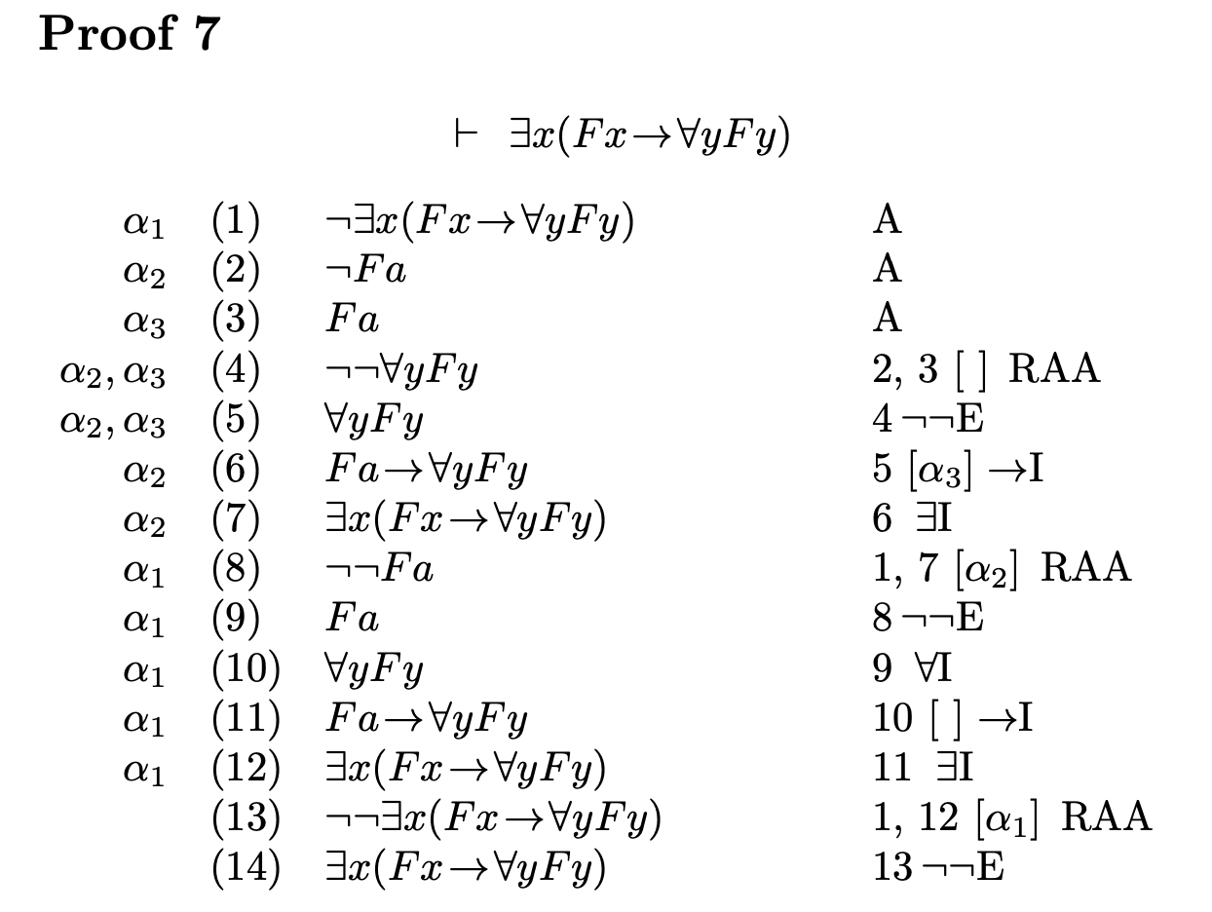
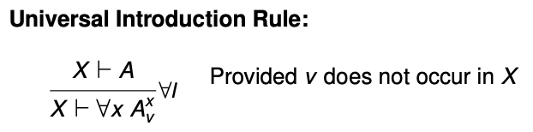
Vacuum discharge

